Slide 1
1.2 Normal Distribution and Relative Standing

Slide 2
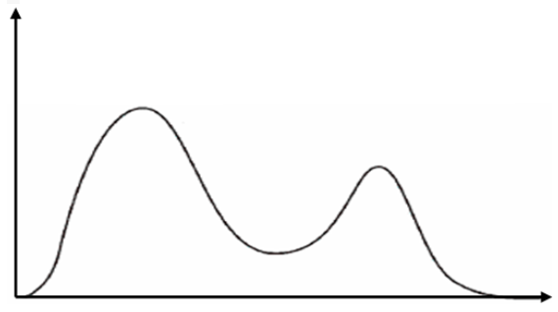
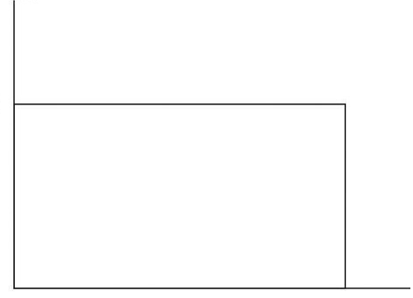
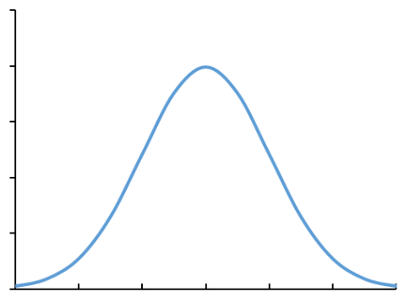
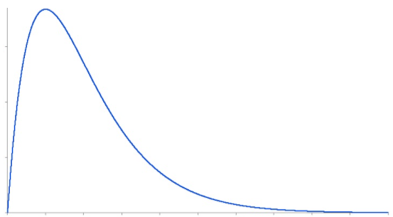
I) What is A Distribution?
Distribution refers to how data is spread out from a range of values
Distribution can be both categorical or quantitative
ie: Suppose you collected the test scores from a large class, the distribution of scores can look like the following:
Uniform Distribution
Q: You open a large box lego and count the number of each of color that there is. What is the distribution of the variable “color”.
Bimodal
Frequency
Frequency
a) The color of the lego: Red, Blue, Green, Yellow, White, Black,
b) The total number of lego pieces in the box
c) Six – the number of different types of colors
d) The six different colors and how many of each color there are
e) Since “color” is a categorical variable, it can not have a distribution
Test Scores
Test Scores
Bell Curve
Skewed (right)
Frequency
Frequency
Test Scores
Test Scores

Slide 3
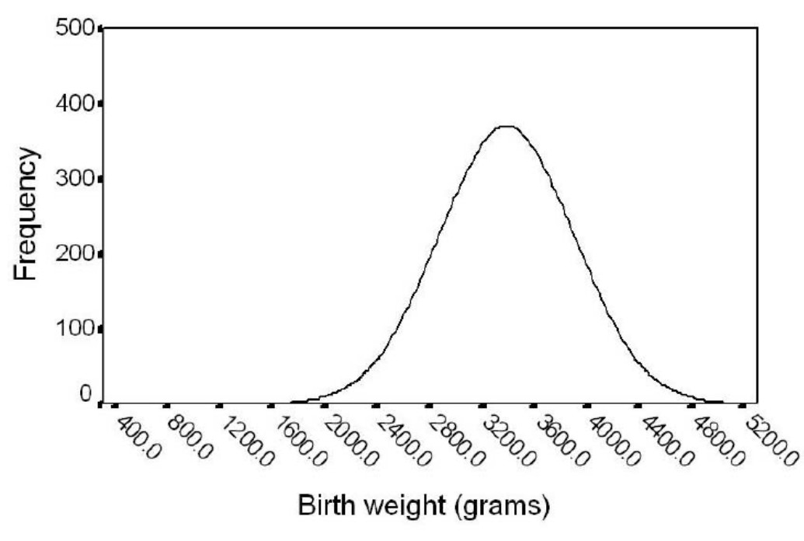
II) What is a Normal Distribution?
A normal distribution is the distribution of a quantitative variable, where the data is symmetrically distributed, no skew, and the distribution is “bell-shaped”
The data is mostly centered in the middle (Mean) and tapers off as the values move away from the mean
In a normal distribution, the mean, median, and mode are all equal
When the distribution of a quantitative variable is normally distributed, it means that the distribution is “bell-shaped”, centered in the mean, no skews

Slide 4
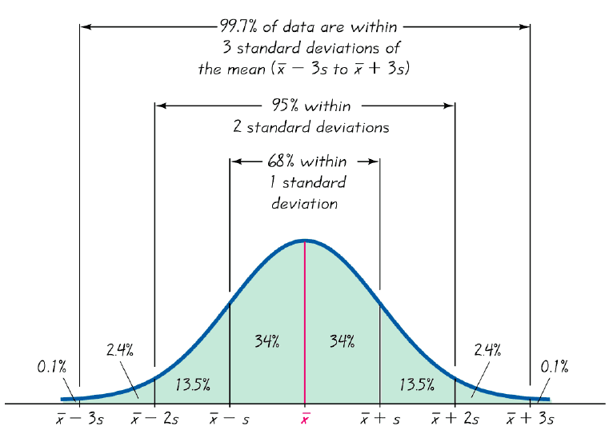
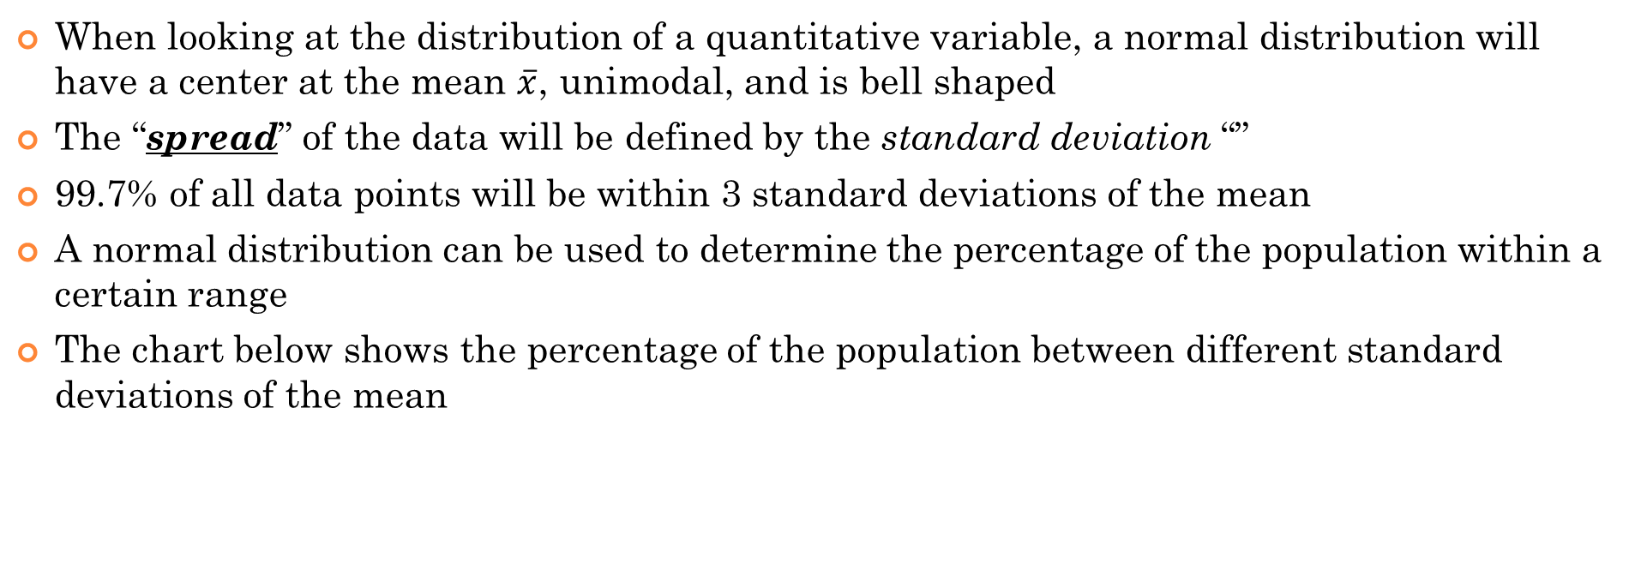
II)Properties of a Normal Distribution?
When looking at the distribution of a quantitative variable, a normal distribution will have a center at the mean $\overline{x}$, unimodal, and is bell shaped
The “spread” of the data will be defined by the standard deviation “”
99.7% of all data points will be within 3 standard deviations of the mean
A normal distribution can be used to determine the percentage of the population within a certain range
The chart below shows the percentage of the population between different standard deviations of the mean

Slide 6
Ex: Jake wrote a test and got his score back. His prof told him that he scored 2 SD above the class average. If the distribution was normal, what percentage of the class did he do better?
Ex: The avg. score of the class was 73% and SD was 8%. If Bob scored 57%, how many SD was he below the class average? What percentage of the class did better than Bob?

Slide 7
III) How to describe the Center of a Distribution:
If Distribution is SKEWED [outliers exists], make a BOXPLOT and choose the ‘median’ to describe it
The median is less influenced by outliers
SO use a box plot to describe the distribution and spread of the data
Find and describe Q1, Q3, Med, Min, Max, Range and IQR, indicate all outliers
If Distribution is Symmetrical (BELL SHAPED Curve) choose the ‘mean’ to describe it
Bell Shaped Curve: symmetrical, shaped like a bell → Normal Distribution!!
Find the mean, standard deviation, and variance to describe the spread of the distribution
A normal distribution will be used as a probability function to calculate the percentage of data above, below, or between a certain data range normalcdf(upper, lower, mean, std dev)

Slide 8
IV) Central tendencies with Skewed Distributions
When the distribution is symmetrical, the mean, median, and mode will be equal
Mean, Median, Mode
When outliers exist, the graph will be skewed. The mean is affected more than the median
Mode
Mean
Mean
Mode
Median
Median
Tail on the right (Skewed Right)
Tail on the left (Skewed left)

Slide 9
The following graphs shows the mark distribution of 3 university math classes. Use the graph to answer the following questions:
Class A
Class B
Class C
50%
75%
100%
50%
75%
100%
50%
75%
100%
Q: Which class is skewed right?
Q: Which class is skewed left?
Q: Which class has the greatest mean / median?
Q: Which class has the greatest number of students?
Q: Which class would you want to be in? Why?

Slide 10
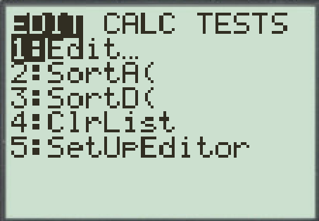
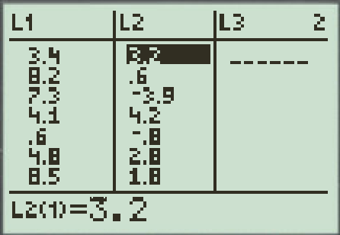
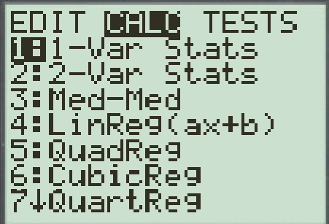
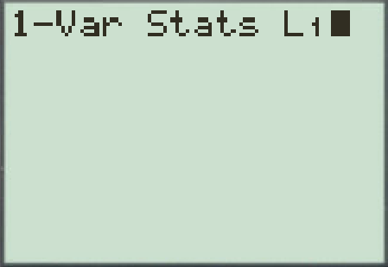
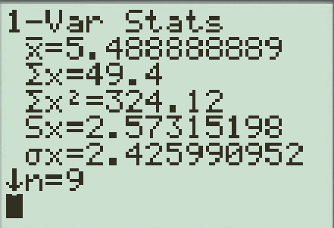
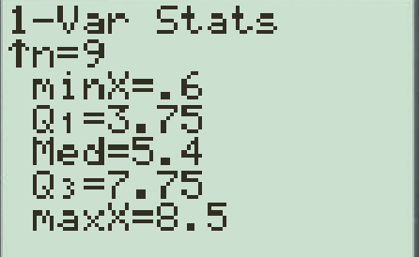
V) Measures of Central Tendencies
Mean - The sum of all the values divided by the number of values
Sample
Population
Median - Arrange all the values in order. Odd number of values, take the number in the middle. Even number of values, take the average of the two middle numbers.
Mode - The term that appears the most frequently
Bimodal – two values that have the same greatest frequency
Multimodal – more than two values with same greatest frequency
Midrange – Halfway between the lowest & highest value
When asked to find “mean,median,or mode, use Ti83. Don’t waste time doing by
hand. Type all data into L1 and do a 1 variable stats test.

Slide 11
Ex: The test scores of a math 12 exam are listed below. Use the information to find the mean, median and mode:
In your groups, discuss the questions below:
68, 75, 70, 85, 88, 74, 75, 77, 15, 92, 80, 75, 80, 69, 81
Q: Find the mean, median, and mode from the data set
Q: Are there any outliers or values that lie outside the overall pattern?
Q: How would the mean, median, and mode be affected if the lowest score was gone?
Q: Which measures of central tendency was most affected and least affected by the unusual score?
Q: Construct a histogram for the original data with a Ti-83 and describe the shape of the distribution
Q: Which measure of central tendency would best represent the average of the class?

Slide 12
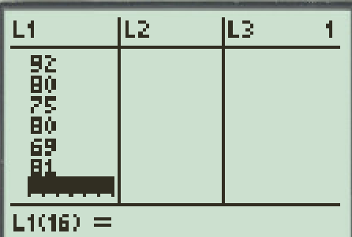
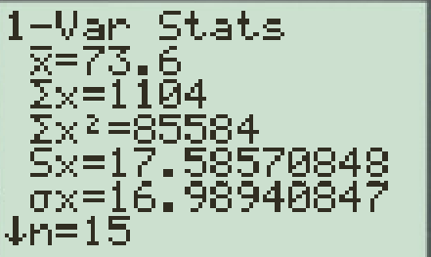
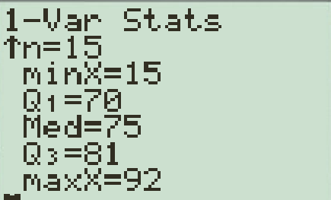
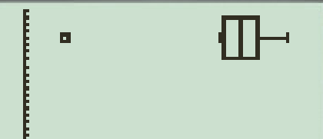
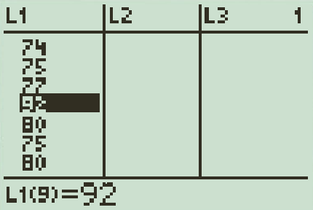
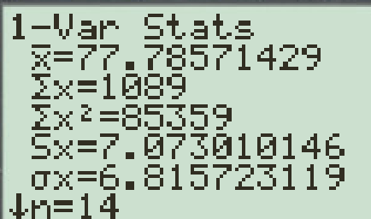
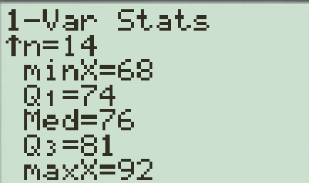
Ex: The test scores of a math 12 exam are listed below. Use the information to find the mean, median and mode:
68, 75, 70, 85, 88, 74, 75, 77, 15, 92, 80, 75, 80, 69, 81
Q: Find the mean, median, and mode from the data set
Q: Are there any values that lie outside the overall pattern?
IQR = 11 and 1.5 x IQR = 16.5
Q1 – 16.5 = 53.5. Minimum is less than 53.5
Yes, the minimum value of 15 is an outlier
Q: How would the mean, median, and mode be affected if the lowest score was gone?

Slide 13
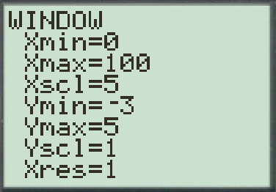
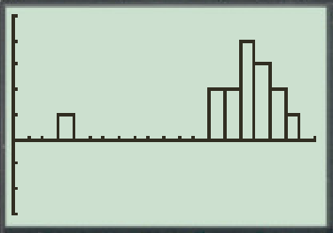
Q: Which measure of central tendency was affected most by the unusual score of 15?
The mean was affected the most, it increased from 73.6 to 77.79
Q: Which measure of central tendency was not affected by the unusual score of 15?
The mode was not affected by the outlier
The median also had very little affect. It increased from 75 to 76
Q: Construct a histogram for the original data with a Ti-83 and describe the shape of the graph
The graph is skewed to the left because of the unusual score of 15. without the outlier, the distribution is somewhat symmetrical centered around 75
Distribution Graphs
Q: Which measure of central tendency would best represent the average of the class?
In this case, the median would be the best measure of central tendency because it was not heavily affected by the outlier. The median was also close to the center of both distributions with and without the outlier.

Slide 14
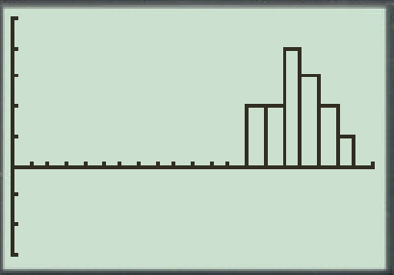
Distribution with Outlier
Distribution without Outliers
Mean
73.6
Mode
75
Mean
77.78
Outlier
15
Mode & Median
75
Median
76
Return to page

Slide 15
What is Variance $σ$² and Standard Deviation $σ$?
Suppose you have 5 data points: 4, 6, 8, 10, 12 with an average of 8
Take each data point, subtract the mean, and then square it. This will give us the variation of each data point from the mean squared
The variance will be the average of all these variations squared
Some variations are positive and some are negative. Squaring them will make them all positive, so that we don’t want to cancel them out…..
The standard deviation is the square root of the variance
We square root to compensate the squaring of the variation

Slide 16
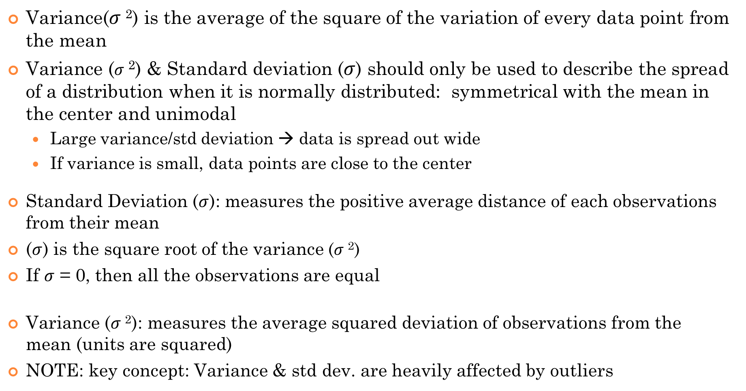
VI) Measuring Spread for Bell Shaped Curves: Variance & Standard Deviation
Variance($σ$²) is the average of the square of the variation of every data point from the mean
Variance ($σ$²) & Standard deviation ($σ$) should only be used to describe the spread of a distribution when it is normally distributed: symmetrical with the mean in the center and unimodal
Large variance/std deviation → data is spread out wide
If variance is small, data points are close to the center
Standard Deviation ($σ$): measures the positive average distance of each observations from their mean
($σ$) is the square root of the variance ($σ$²)
If $σ$ = 0, then all the observations are equal
Variance ($σ$²): measures the average squared deviation of observations from the mean (units are squared)
NOTE: key concept: Variance & std dev. are heavily affected by outliers

Slide 17


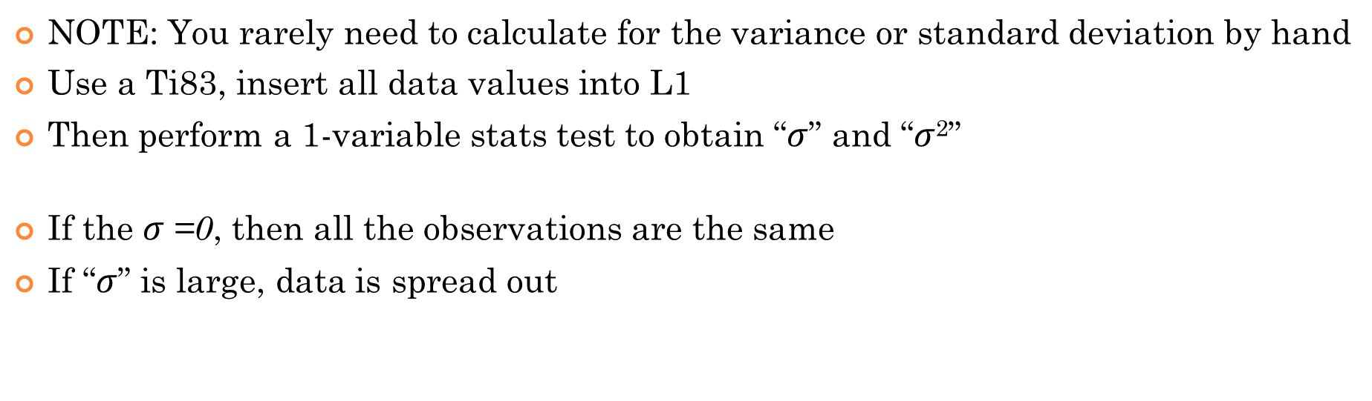

VII) FORMULAS for Variance & Standard Deviation
NOTE: You rarely need to calculate for the variance or standard deviation by hand
Use a Ti83, insert all data values into L1
Then perform a 1-variable stats test to obtain “$σ$” and “$σ$²”
If the $σ$=0, then all the observations are the same
If “$σ$” is large, data is spread out
Variance($σ$²):
Standard Deviation ($σ$) (SD):
Standard Deviation ($σ$) is 16.989:

Slide 18
Q: Do Outliers affect Var. and Std. ?
Outliers greatly influences the mean. Therefore, it will affect both Var. and Std.
Q: If all values in a data increased by 3 units, how will the Var. and Std. Dev. be affected ?
If all values are increased by the same value, the variation should NOT increase. So variance and sd will remain the same

Slide 19
Question: The following graph shows the project scores between two students. If you can choose one of them to be your partner for a project, which will you choose?
Student A
Student A
What information about each students’ project scores can you get from this distribution graph?
Student A is more consistent, → less variability, scores are close to the mean of 75%
Student B has a greater spread on his/her project score → greater variability, scores can be higher or lower
Note: Student A has less variance with his/her project scores
Student B has greater variance with his/her project scores

Slide 20
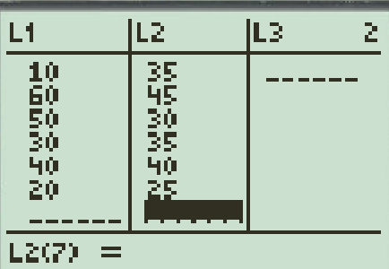
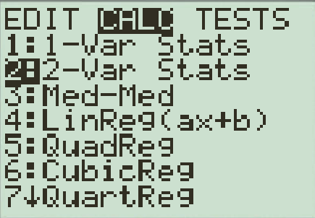
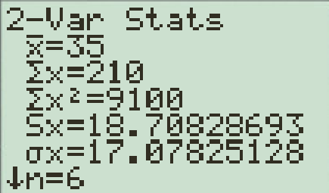
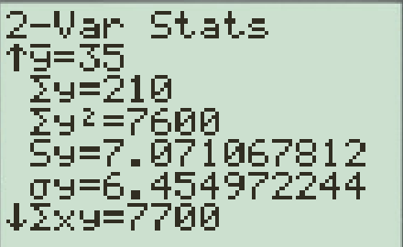
Two outdoor paints were tested to see how long each will last before fading. Six pails (3.8L) of each paint were tested. The results are given in number of months. A) What measures of central tendencies would you use to compare the two paints? B) find the mean, variance, and standard deviation for each paint and make comparisons c) How would you decide which Paint is Better?
Type both data sets into L1 and L2
Paint A: mean = 35 Std Dev = 17.078
Variance = 291.66
Paint B: mean = 35 Std Dev = 6.4549
Variance = 41.666
Q: Which paint is better?
Paint “B” will have more consistency in quality and last around the same time. It is better to purchase paint with consistency.

Slide 21
Given each box plot, indicate which best describes each one:
A
B
C
Q: Which group has the greatest variability?
Group “C” will have the greatest variability because it has the largest range
Q: Which group has the least variability?
Group “B”, despite the outlier, most of it’s data is very close to its median
Q: Which group has the greatest mean?
Since outliers can greatly influence the mean, I would assume Group “C’ to have the largest mean.
Q: Which distribution is approximately normal?
Group A is the most symmetrical and does not have any outliers.

Slide 22
In UBC Math 100, 50 students wrote a test and got a class average of 74% with a SD of 8.5%. The teacher decides to exempt 2 questions and give everyone 3 extra percentage points. Which of the following changes to the mean and SD will happen?
a) The mean and SD will stay same b/c increasing everyone’s mark by 3% will not change anything b) The mean will increase by 3% but not the SD
c) The mean will stay the same but the SD will increase by 3%
d) The mean will increase by 3% but the SD can increase by any amount depending on what marks each student had
e) It is impossible to find the new mean and SD without knowing what the actual marks of the students were

Slide 23
Which of the following will help decrease the standard deviation? YES OR NO??
a) Increasing the mean in a set of data
b) Removing the outliers in a set of data
c) Decreasing each data point by 5% in a set of data
d) Removing the largest or smallest data points

